Slide 1
Spring 2022 Chair Workshop

Slide 2
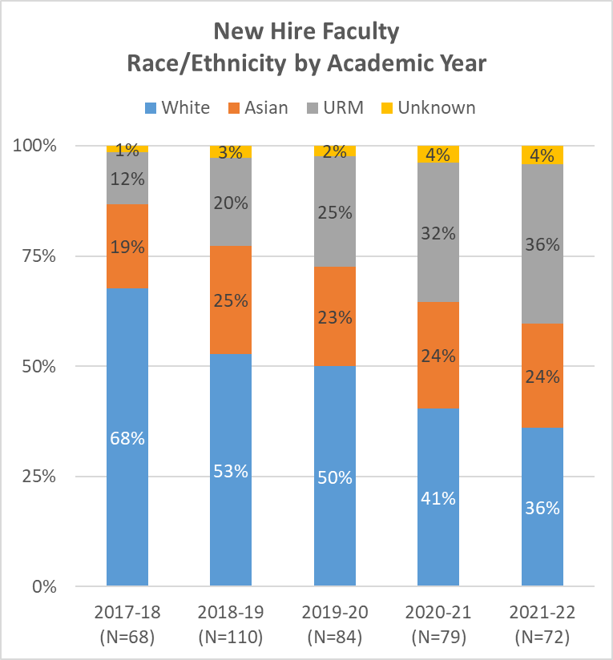
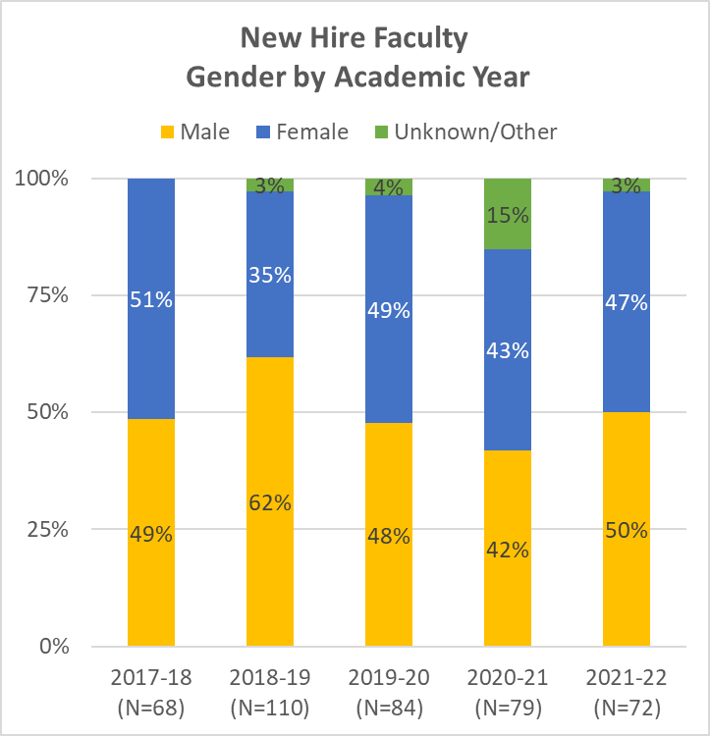
Thanks to you there was a large increase in diversity of new faculty hires over last 5 years
Notes:
The changes in overall diversity of faculty are being driven by a large increase in the diversity of new faculty hires over the last 5 years. The change in demographics include URM faculty increasing from 12-36% and Asian faculty from 19-24%. For the last two years more than 50% of the new hires identified as nonwhite. We are close to gender parity in hiring across the last 3 years as well. A number of focused hiring programs have contributed to diversification of our new cohorts as illustrated by looking at the number of faculty hired in 21-22 by program. Our UCI IE Supplement program included 20 of 72 total hires. The PPFP program accounted for 11 out of 72 hires. We also have the Black thriving initiative which is a new program for this coming year that we hope will further increase faculty diversity. I should also mention that we subscribe to and post of all our ads to Texas Tech and National Job Registry which is a searchable database by diverse candidates and provides a place for position postings that are visible to their candidate pool.
We also have programs in place to support newly recruited diverse faculty, starting with the important engagement of Equity Advisors in the search process, various programs supported by UCOP Advancing faculty diversity grants for recruitment and retention. Among the latter are a program for assistant and associate professor URM women called Elevate women and U See I Write research writing accountability groups.

Slide 3
Hiring Programs
Inclusive Excellence Supplement
2019-20: 16 nominations
13 approved (4 STEM)
22 (of 26) faculty accepted offer
Total faculty hires = 81
2020-21: 17 nominations
14 approved (5 STEM)
20 (of 28) faculty accepted
Total faculty hires = 72
Notes:
The Provost’s office has also strongly encouraged all Deans to work with their Chairs to proactively identify potential candidates from the PPF hiring program. Our campus has been very successful in identifying and attracting new faculty through this program in nine of our 15 schools as seen in left graph. While we have been generally more successful in the non-STEM schools, we have hired STEM faculty through this program as well.

Slide 4
COVID Impact Mitigation Programs in 2021-22
INTERIM COVID MODIFIED DUTIES (ICMD) PROGRAM: For assistant professors with dependent care responsibilities to devote their time to scholarly activity, cost-shared with Schools.
In place for five quarters: from Winter 2021 through Spring 2022
Total faculty requests: 48
Funded requests: 46 for 50 courses
Invested $142,087 campus funding to cost-share with Schools
INTERIM COVID RESEARCH RECOVERY PROGRAM (ICRRP): For assistant and associate professors to recover losses in research due to COVID-19.
Two award cycles: Fall 2021 and Winter 2022
Total faculty applications: 123
Funded Applications: 95 across 11 schools
Amount funded: $1,099,558
The Provost allocated an additional $1,000,000 for this program in 2022-23.

Slide 5
Revised policies out for comment
APM: Abusive conduct in the work place
Academic Senate: Mitigating impacts of COVID-19 Faculty workgroup.

